Slide 1


To learn to use Can for invitations
Can you come to… on …?
To learn to accept and decline invitations and give reasons
Sure, I’d love to./That sounds great.
I’m not sure. I might …
Sorry, I might have to …
To learn to use might to talk about possibility and use must and have to to talk about obligations

Slide 2


1. 为考试而做准备
2. 看医生
3. 上钢琴课
4. 帮助我的父母亲
5. 拜访我的姑姑
prepare for an exam
go to the doctor
have a piano lesson
help my parents
visit my aunt

Slide 3
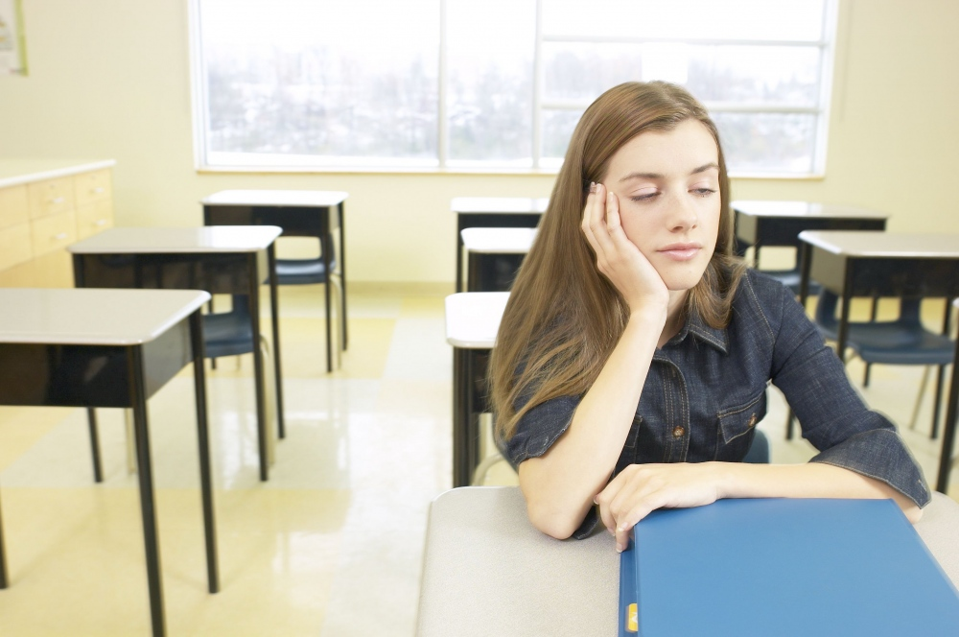
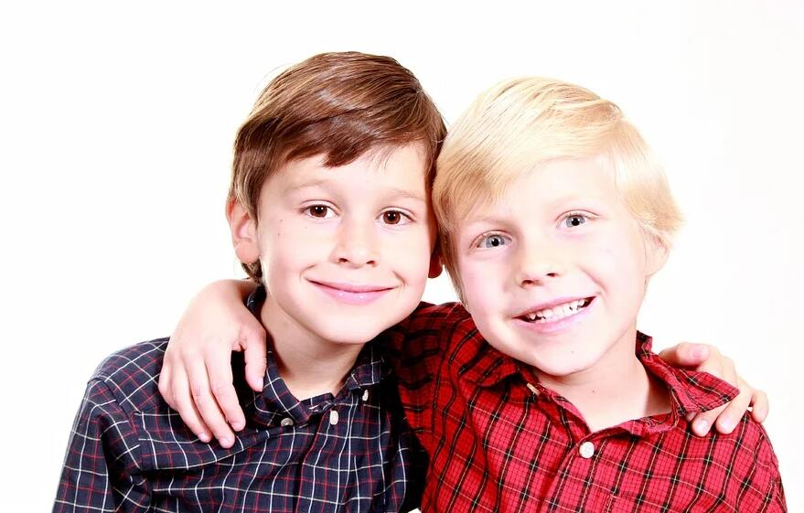
Practice the following conversations.
Can you play tennis with me tomorrow afternoon?
Sure. I’d love to.
I’m afraid not. I have the flu.

Slide 4
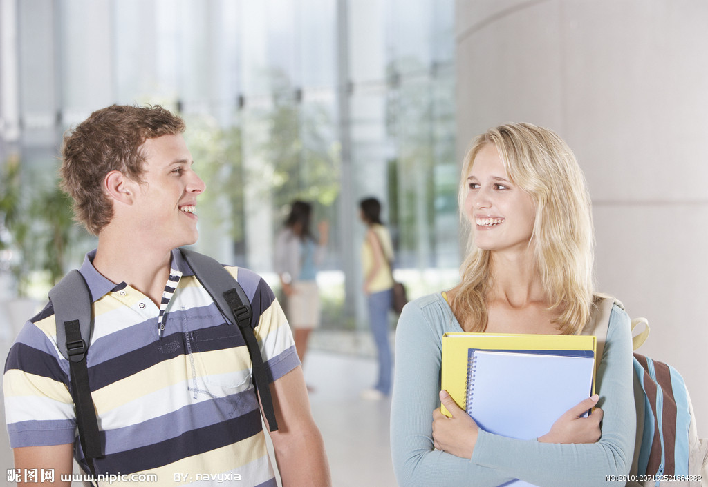
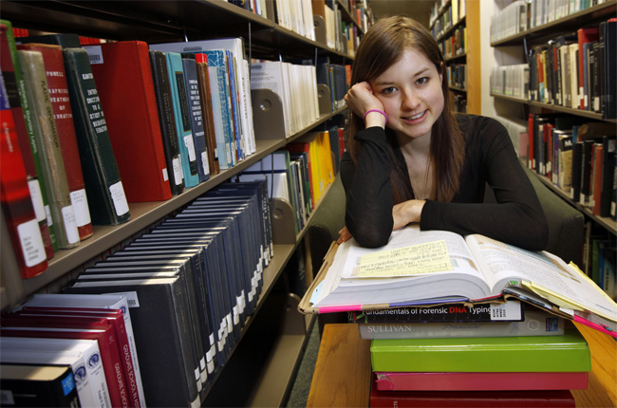
Can Kate go fishing tomorrow morning?
No, she can’t. She must prepare for the math exam.

Slide 5
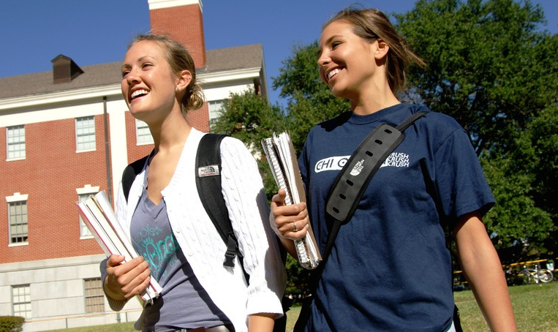
Can Nick and Peter go bike riding tomorrow?
No, they are not free. They might have to visit their grandparents.

Slide 6

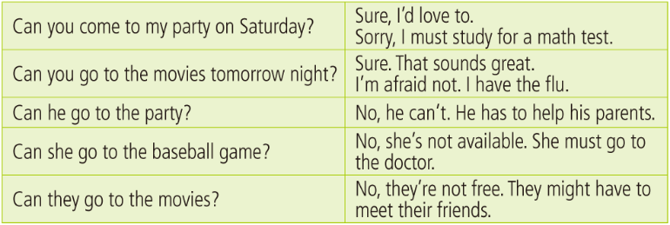
Observe
用can发出邀请
接受邀请
用can打听第三方是否能参加聚会，表示一种可能性。
拒绝邀请
说明理由

Slide 7

Unit 9

Slide 8

Unit 9
Can you come to my party?

Slide 9

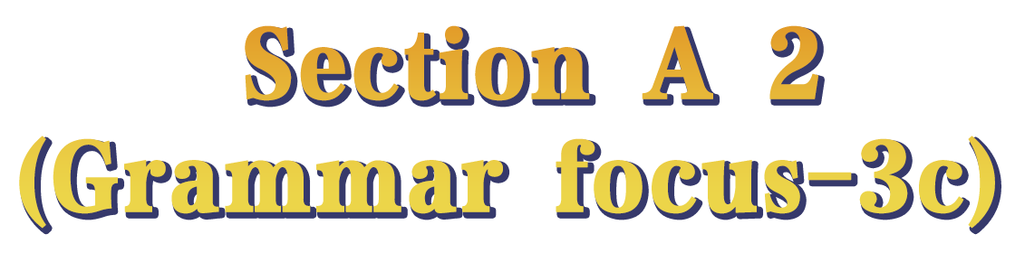

Slide 10

根据课本内容, 完成下列句子。
1. 星期六你能来我的聚会吗？
_______ you _______ to my party on Saturday?
2. 当然, 我乐意去。
Sure, _______ _______ _______.
3. 对不起, 我必须为数学考试备考。
Sorry, I _______ ____________ _______ a math test.
Can come
I’d love to
must study/prepare for

Slide 11
4. 明天晚上你能去看电影吗？
_______ you _______ to the movies tomorrow night?
5. 当然可以, 听起来很棒。
_______. That _________ _______.
6. 恐怕不行, 我得了流感。
I’m ________ not. I have the _______.
7. 他能参加聚会吗？
_______ he _______ to the party?
8. 不能。他得帮助他的父母。
No, he _______. He _______ to help his parents.
Can go
Sure sounds great
afraid flu
Can go
can’t has

Slide 12
9. 她能去看棒球比赛吗？
_______ she go to the baseball _______?
10. 不，她没有空。她必须去看医生。
No, she’s _______ ________. She _______ _______ to the _______.
11. 他们能去看电影吗？
_______ they _______ to the _______?
12. 不, 他们没有空。他们可能得去见朋友。
No, they’re not _______. They _______ _______ _______ meet their _______.
Can game
not available
must go
doctor
Can go movies
free might have to
friends

Slide 13
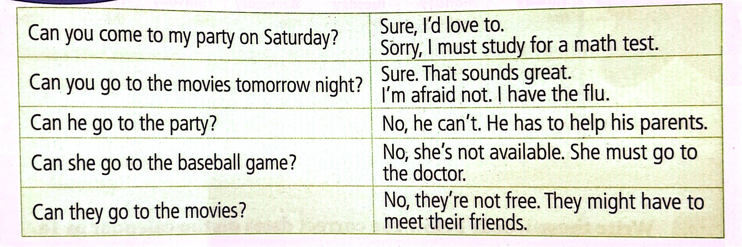
Can you find the rule?
can表示“做某事的可能性”。
无论主语是什么，动词用原形。
can引导的一般疑问句由Yes, ...can.或No, ...can’t.作回答。
might表示推测和可能性。
它的可能性比can, could ,may小,也最委婉，最有礼貌。

Slide 15



Complete the answers with might and one of the phrases in the box.
watch TV, on the weekend, my cousin,
visit my grandparents, practice the violin
1. A: What are you going to do on Saturday?
B: I’m not sure. I might ________________________.
visit my grandparents/...
2. A: What are you planning to do after school?
B: I don’t know. ________________.
3. A: When will you finish the science homework?
B: _____________________________________________.
I might watch TV/...
I might finish it on the weekend

Slide 16
watch TV, on the weekend, my cousin,
visit my grandparents, practice the violin
4. A: Who are you going to the movies with?
B: ______________________________________.
5. A: Are you free to come to my place on Saturday?
B: ______________________________________________.
I might go with my cousin
I might have to practice the violin/...

Slide 17

Complete the sentences below. Use the words in brackets to help you.
Can you play tennis with me on Saturday afternoon?
1. Inviting: ______________________________ (can/play tennis)
Accepting: __________________________________________
2. Inviting: ____________________________________________ (would like to/go to the movies)
Refusing: __________________________________________
Reason: ____________________________________________
(might have to)
Sure, that sounds great.
Would you like to go to the movies with me tonight?
Sorry, I can’t.
I might have to go out with my parents.

Slide 18
Can you hang out with us tonight?
3. Inviting: __________________________________________
(can/hang out with us tonight)
Refusing: _________________________________________
Reason: ___________________________________________
(must)
4. Inviting: __________________________________________ (would like to / come to my birthday party)
Accepting: ________________________________________
Sorry, I am not free.
I must study for a test.
Would you like to come to my birthday party?
Sure, I’d love to.

Slide 19

Write down everything you have to do next week. Choose a day and time to have a party.
 | Morning | Afternoon | Evening
MON.
TUE.
WED.
THUR.
FRI.
SAT.
SUN.

Slide 21

情态动词might的用法
They might have to meet their friends.
might表示推测和可能性。它的可能性比may小。
e.g. She might not want to come with us.
她可能不想和我们一起走。
How long might the travel take?
这次旅行需要多长时间？
Dad might know how to start that machine.
爸爸也许知道如何发动那台机器。

Slide 22
can表示可能性
can表示“做某事的可能性”。
无论主语是什么，动词用原形。
can引导的一般疑问句由can或can’t作回答。
Can go to the party?
肯定答语：Yes, he / she / they can.
否定答语：No, he / she / they can’t. 或No, he / she is / they are not available.等。

Slide 23
Invite your classmates to your party.
v. 邀请
Example:
A: Can you come to my party?
B: When is it?
A: Next week, on Thursday night.
B: I’m sorry. I have to study for a math test.

Slide 24
can表示请求
“Can you come to/ go to…?” can引起的问句可以表示委婉的请求或邀请，回答方式灵活多样，可根据具体情况作出礼貌回答。
Sure. That sounds great.
如果接受邀请，答语可用：______________________ / _______________等。
Sure, I’d love to.

Slide 25
【拓展】
表示同意邀请的回答还可用：
Yes, I’d love/like to.
Sure, it sounds great.
Certainly, I’d love/like to.
Sure, I’d love/like to.
Thanks for your invitation.
Thanks for asking me.

Slide 26
如果拒绝邀请，答语可用：
I’m sorry. I’m not free/available.
Thanks for your invitation. I might have to/must...
Sorry, I’m afraid not. I might have to/must...
Sorry, I can’t. I might have to/must...
I’d love to, but I have to…
No, I can’t. I’m going to ...
Thank you for asking me. But ....
I am afraid not, I...

Slide 27
【拓展】其他提出邀请的句型：
Could/ Will you…?
Would you like to ...?
How/ What about ...?
Why not ...?
Let’s ...
I hope you ...

Slide 28
can表示可能性
can表示“做某事的可能性”，意为“可以”(可用来询问打听第三方能否参加某项活动)。对这种情况下can引起的问句仍由can或can’t作肯定或否定回答。
如课本中的句子Can he go to the party?
肯定答语：Yes, he / she / they can.
否定答语：No, he / she / they can’t. 或No, he / she is / they are not available.等。

Slide 29
e.g. —Can he come here before nine tomorrow morning?
—No, he can’t. He has to go to the music club first.
—Can Alice go to the movies with us tonight?
—Yes, she can. /
No, she’s not available. She has to look after her sister.

Slide 30
情态动词might用法
They might have to meet their friends.
might在此表示推测和可能性。它的可能性比may小。
e.g. She might not want to come with us.
她可能不想和我们一起走。
How long might the travel take?
这次旅行需要多长时间？
Dad might know how to start that machine.
爸爸也许知道如何发动那台机器。

Slide 31

1. There is no light on-they _______ be at home.
A. mustn’t B. can’t C. needn’t
(2021黑龙江牡丹江鸡西中考)
2. —I wonder if this glass is Tom’s.
—It ______ be his. His was broken just now.
A. mustn’t B. may not C. can’t D. shouldn’t
(2021湖北黄石中考)
B
C

Slide 32
3. —Sam, ________ I join you in the community service?
—Of course you can.
A. can B. must C. should D. need
4. We____ have a graduation ceremony next week, but I'm not
sure.
A. must B. need C. might
(2021黑龙江绥化中考)
A
C

Slide 33


1. might & can
2. Making an invitation:
Can you …?
Would you like to …?/Do you want to …?
3. Accept or refuse an invitation:
v. 接受
v. 拒绝

Slide 34
接受邀请：
Yes, I’d love/like to.
Sure, that sounds great.
Certainly, I’d love/like to.
Sure, I’d love/like to.
Thanks for your invitation.
Thanks for asking me.

Slide 35
拒绝邀请：
I’m sorry. I’m not free/available.
Thanks for your invitation. I might have to/must...
Sorry, I’m afraid not. I might have to/must...
Sorry, I can’t. I might have to/must...
I’d love to, but I have to…
No, I can’t. I’m going to ...
Thank you for asking me. But ....
I am afraid not, I...

Slide 36


Ⅰ. 根据语境及所给首字母提示，补全所缺单词。
1. Miss Miller, happy birthday to you! Please a this small gift.
2. —Kelly, can you come to my party this evening?
—Sure. It’s very kind of you to i me.
accept
invite
3. Alice r my help. She said she could finish it by herself.
refused

Slide 37
Ⅱ. 根据情景提示，用can写句子或将句子补充完整
1. 你想邀请Helen这周末和你一起去看电影，你可以这样问：
________________________________ with me this weekend, Helen?
Helen接受你的邀请，她可以这样说:
____________________________________________________
____________________________________________________.
Helen拒绝你的邀请，理由是她得去看她的爷爷奶奶，她可以这样说：
I’m sorry, I can’t. ____________________________________.
Can you go to the movies / cinema
Sure, I’d love to / Sure. That sounds great / Yes, sure / Yes, I can
I must / have to visit my grandparents

Slide 38
2. 你想向Nick打听Cindy明天上午能否去爬山，你可以这样问：
Nick, _____________________________________________ tomorrow morning?
Nick得知Cindy明天上午没有空，理由是她可能得去看医生，Nick可以这样说：
No, she’s not free. __________________________________
__________________________________________________.
can Cindy go to the mountains / go climbing
She might have to go to / see the / a doctor

Slide 39


Write down the results of your invitation using the following structure. Give an oral report next class.
Structure:
I’m having a party on … I’m glad … is/are coming to my party, but … can’t come because he/she/they …

Slide 40


